Slide 2
Bloomberg's Journey to Improve Resource Utilization in a Multi-Cluster Platform
Yao Weng, Senior Software Engineer
Leon Zhou, Software Engineer
Data Science Platform Engineering @ Bloomberg

Slide 3
Agenda
Challenges with Managing Large GPU Clusters
Bend the GPU Growth Curve with Scheduler
Data Science Platform & Karmada at Bloomberg
Future Project Roadmap

Slide 4



Data Science Platform at Bloomberg
On-prem bare metal Kubernetes Infrastructure for full machine learning lifecycle
Experiment
Train
Inference

Slide 5
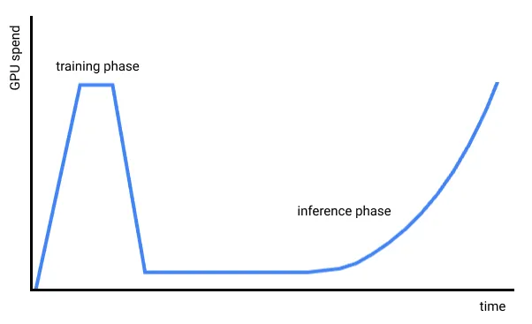
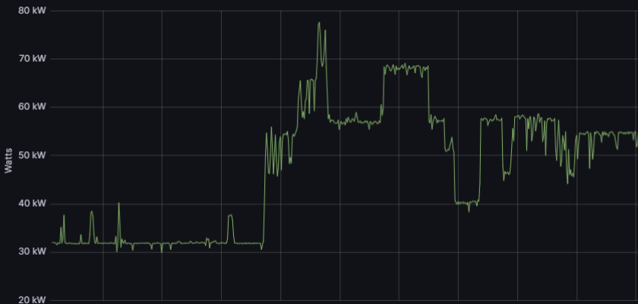
Challenges: Meet Accelerating GPU Demand
Train bigger LLMs
Serve more LLM applications
More power capacity is needed to grow the GPU cluster capacity
Notes:
One of the biggest challenges is keeping up with the accelerating gpu demand.
With each new llm generation, they grow exponentially in size and complexity. The resources needed for training is skyrocketing as a result. Beyond training llm, the surge in inference applications are at the core
Of many real-time applications -everything from chatbots to recommendation systems. Each requiring GPUs to run continuously and reliably.
And both of these require new generation of GPUs that can handle vast amount of data and billions of parameters, constantly raising the bar for infrastructure requirements.
That also brings out the problem of power consumption, today’s GPU nodes can consume 30 times the power of an average node. So, scaling up infra to meet the GPU demand would also require meeting the power consumption requirements and cooling demand.
In addition to growing gpu demand, there’re also challenges we saw that caused low GPU resource utilization rate.

Slide 6
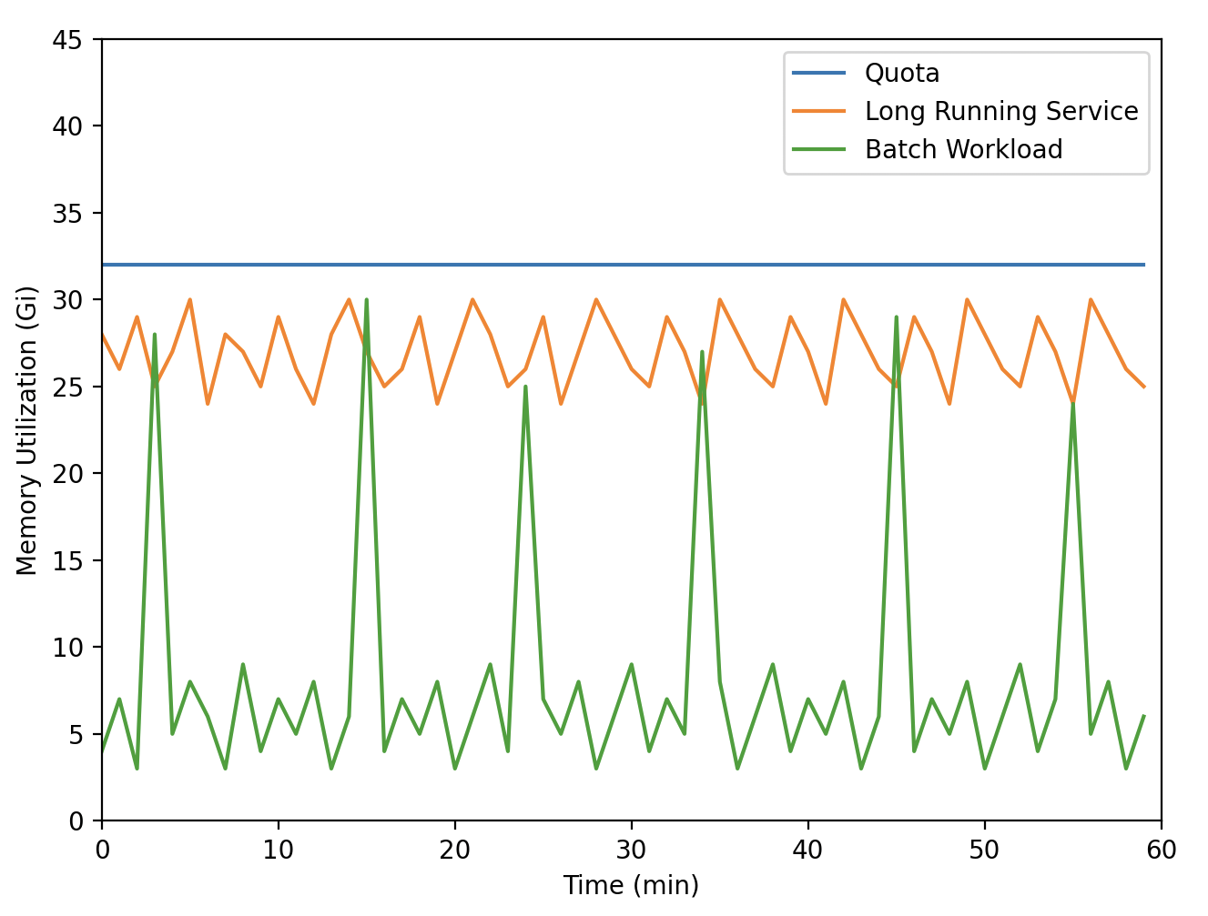
Challenges: Over-budgeting
❓K8s Quota-based budget
Over-budget for peak usage → Waste resources
💡Time-based cost management + Priority & Preemption
Notes:
Static kubernetes resourcequota does not quite well with MLtraining job, which is a batch workload. For batch workload, the resource utilization is low most of the time, but there are sporadic spikes when a large job is submitted into the cluster. However, for long-running services, the resource utilization is relatively stable. The comparison is shown on the diagram. Users must budget for their namespace based on the maximum amount of resource that they could potentially use, which is fine for long-running services, but is not ideal for batch workload. It leads to waste of hardware resources

Slide 7
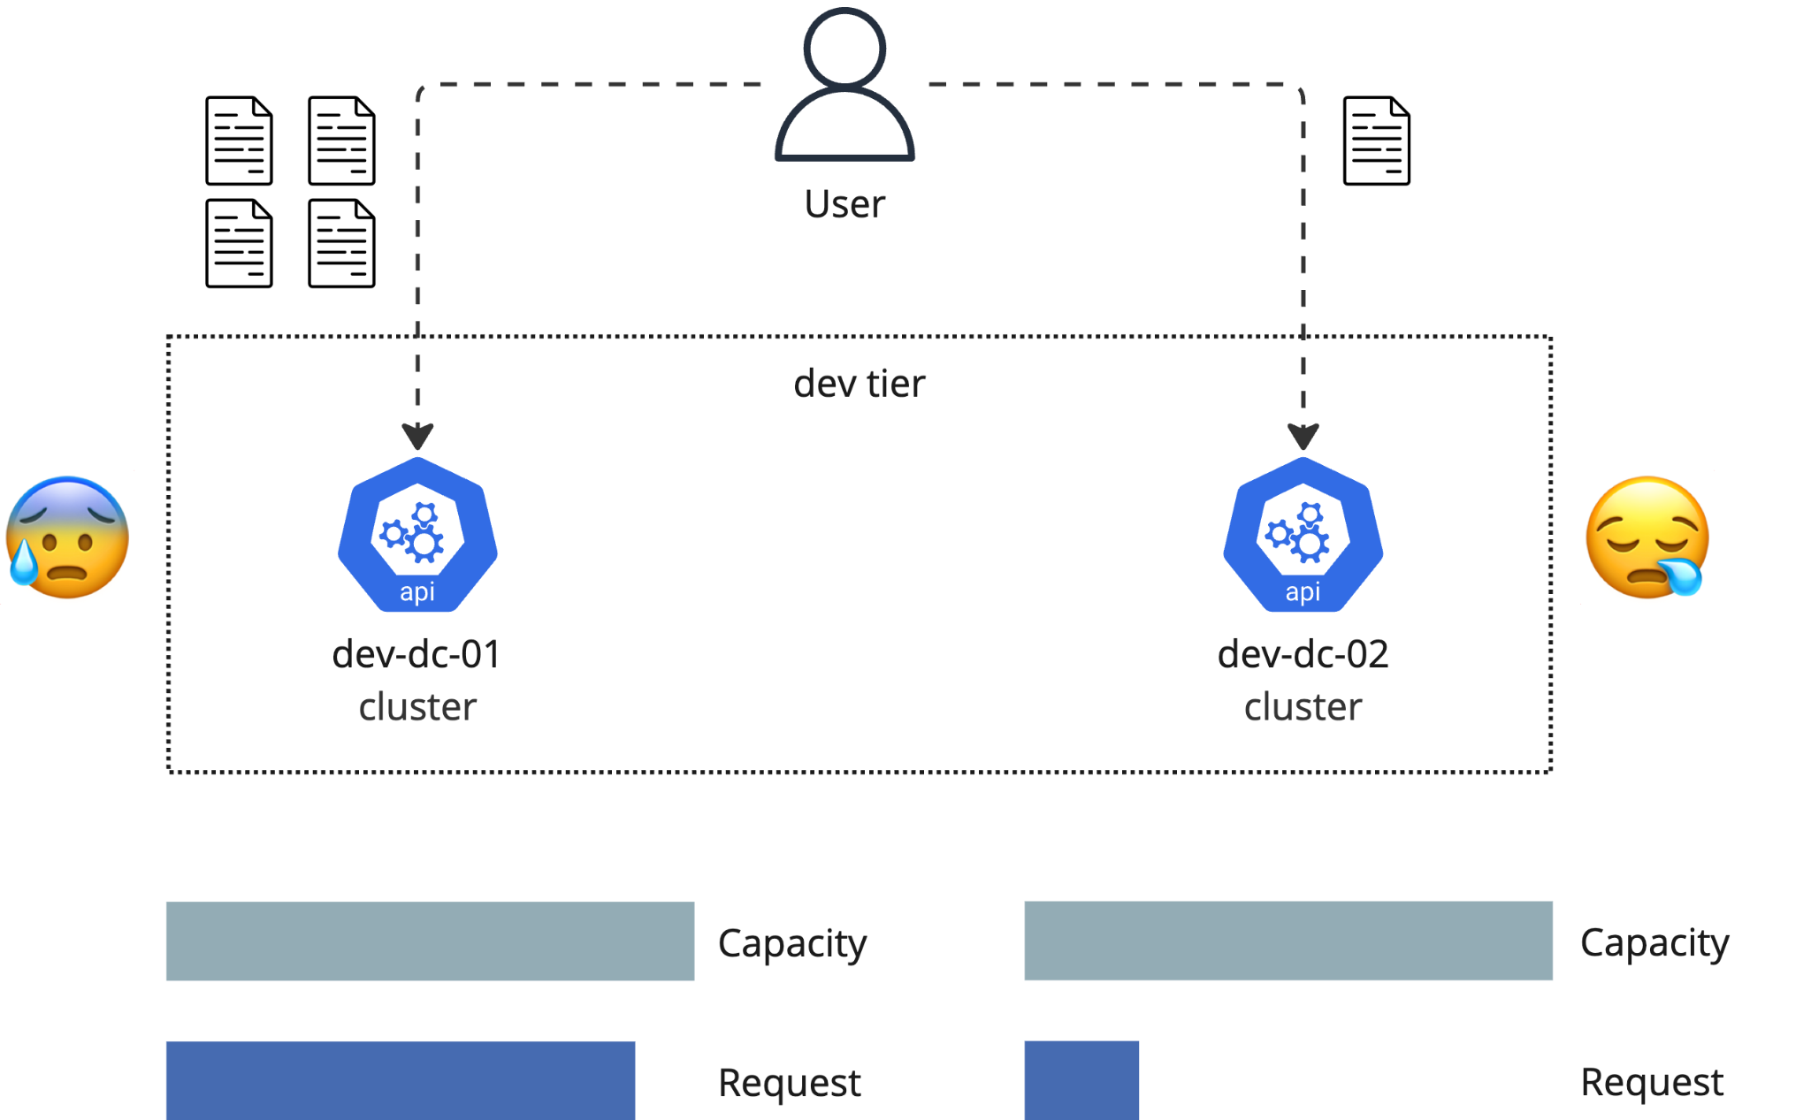
Challenges: Unbalanced Utilization
❓Unbalanced, fragmented resource utilization
💡Submit ML training jobs evenly to different clusters
Notes:
Resource fragmentation
People feel more comfortable with using the cluster that they submit jobs to most of the time, so they probably tend to keep choosing a certain cluster even though they are identical
The solutions to the challenges become more and more unrealistic as it goes. So we need to figure out a better way to resolve all of them.

Slide 8
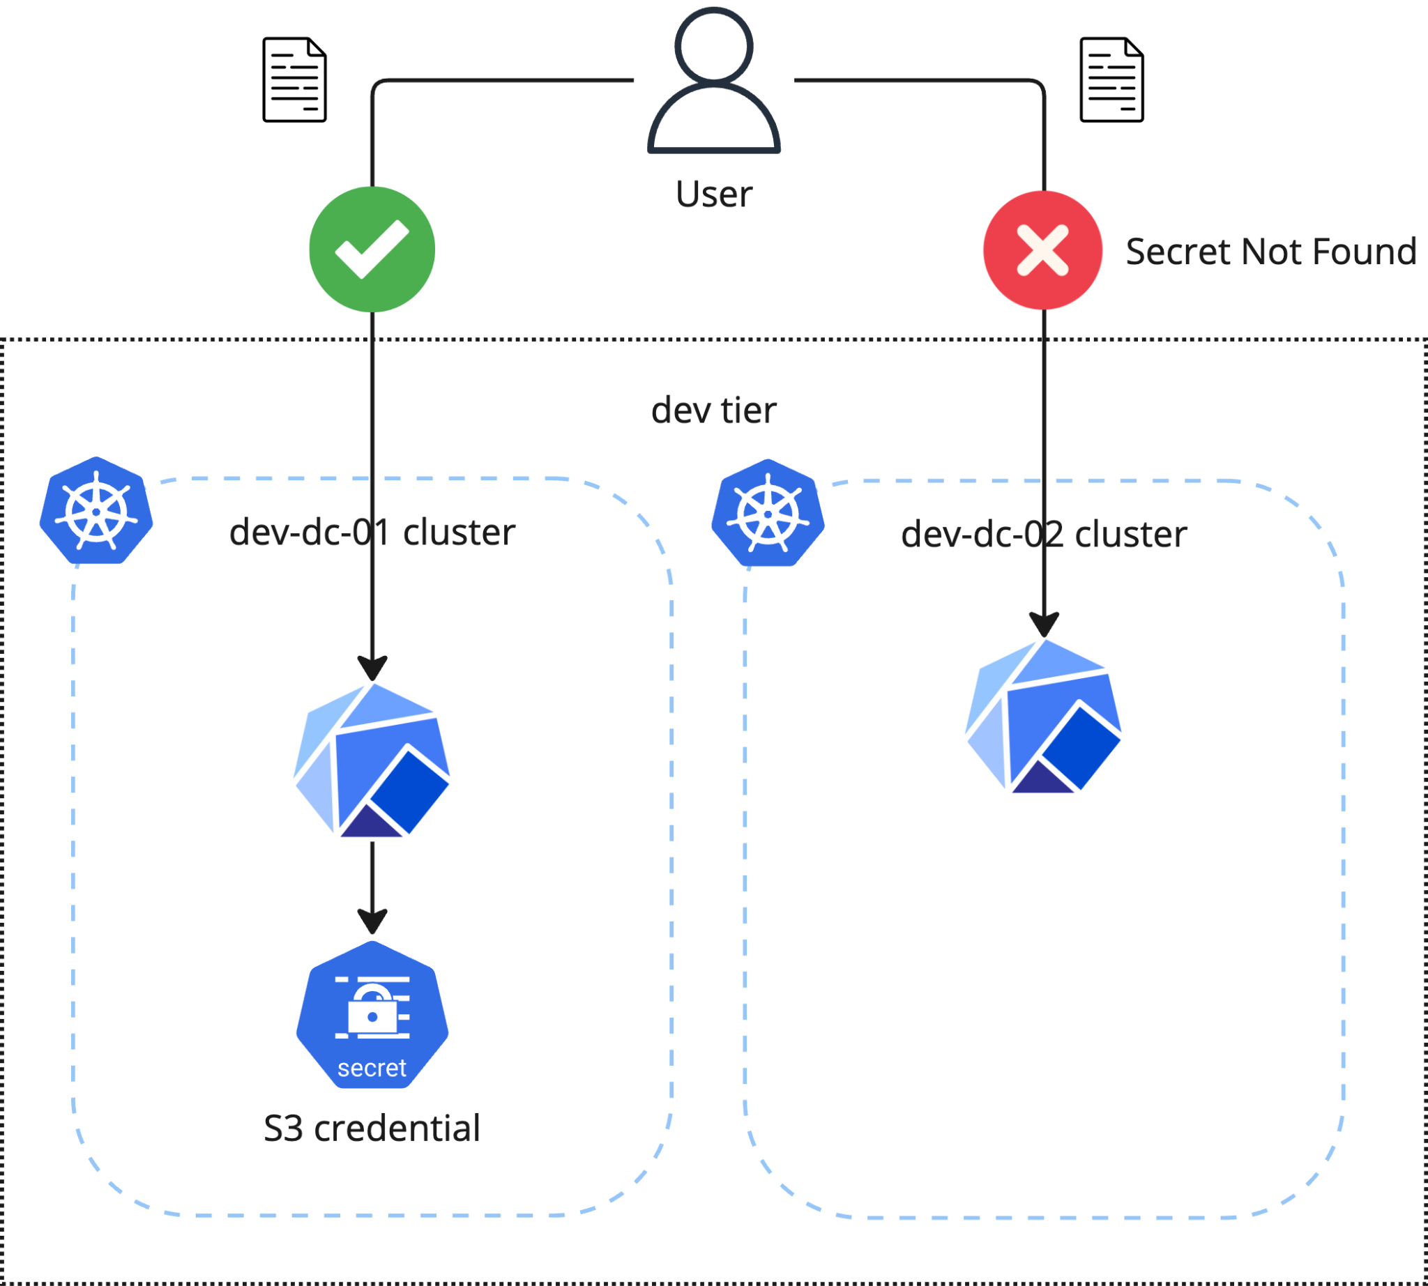
Challenges: Configuration/Credential Management
❓Credentials/Configs are cluster-scoped
💡Auto-copy configurations and credentials to all clusters
Notes:
Another reason blocking balanced computation load over cluster:
A developer wants to launch a ML training job that needs to get an S3 credential stored in a Kubernetes secret. The secret only exists on 01 cluster but not 02, so the same job would be pass on 01 but would fail on 02.
So developers need to manually copy the configurations and credentials that they need onto all clusters in this tier.

Slide 9
Bend the GPU Growth Curve with Scheduler
Built-in Observability
Collaborative & Active Open Source Community
A 10/10 Scheduler🏆
Support ML Batch Workloads
Ease of Maintainability
Designed for
Multi-Cluster, Multi-Tenancy
Notes:
To bend the gpu growth curve, we need a scheduler that can smartly schedule ml workloads. there are several key factors

Slide 10
Bend the GPU Growth Curve with Scheduler
Built-in Observability
Features to increase cluster resource utility
Multi-cluster federation
Workload/Job Queuing
Quota-based budgeting → Time-based
Collaborative & Active Open source Community
A 10/10 Scheduler🏆
Support ML Batch Workload
Ease of Maintainability
Designed for
Multi-Cluster, Multi-Tenancy

Slide 11



In-Cluster vs. Cross-Cluster (Federated) Scheduler
In-Cluster Scheduler
Federated Scheduler
Job
User
Queue(s)
Clusters
Examples
volcano
Notes:
We considered multi-cluster vs. in-cluster and decide to do both federation and scheduling
We these in mind, there are some additional features that will help us improve gpu resource utilization rate.

Slide 12
In-Cluster vs. Cross-Cluster (Federated) Scheduler
Federation of clusters
Federated identity management
Queuing/scheduling
Job prioritization (upstream contribution)
Preemption (upstream contribution)
Integration across the DSP environment
Highly-available scheduler
DSP UI
dspctl
Submit Jobs
Schedule Jobs
Federated API
Federated Identities
Karmada
Prioritization/Preemption
HPC
Training01
Training02
Notes:
To expand on that, a multi-cluster federation will need these features.

Slide 13
Bend the GPU Growth Curve with Scheduler
Built-in Observability
Supports Gang Scheduler for batch workload (e.g., distributed PyTorch)
Priority & Preemption
Scheduling & Cancelling workloads
Collaborative & Active Open Source Community
A 10/10 Scheduler🏆
Support ML Batch Workload
Ease of Maintainability
Designed for
Multi-Cluster, Multi-Tenancy

Slide 14
Bend the GPU Growth Curve with Scheduler
Built-in Observability
Monitor workload location in queue
Monitor size of the queue
Integrate with Prometheus
Preemption notifications
Collaborative & Active Open source Community
A 10/10 Scheduler🏆
Support ML Batch Workload
Ease of Maintainability
Designed for
Multi-Cluster, Multi-Tenancy

Slide 15
Bend the GPU Growth Curve with Scheduler
Built-in Observability
Owned by a foundation (the project is neutral)
Strong community
Good documentation
Mature Project and Internal Adoptions
Collaborative & Active Open source Community
A 10/10 Scheduler🏆
Support ML Batch Workload
Ease of Maintainability
Designed for
Multi-Cluster, Multi-Tenancy

Slide 16
Bend the GPU Growth Curve with Scheduler
Built-in Observability
Ease of Maintainability
Ease to deploy the scheduler
Ease to integrate with DSP Infrastructure
Collaborative & Active Open source Community
A 10/10 Scheduler🏆
Support ML Batch Workload
Ease of Maintainability
Designed for
Multi-Cluster, Multi-Tenancy

Slide 17

Karmada
🙆🙆‍♀️🙆‍♂️

Slide 18
Open, Multi-Cloud, and Multi-Cluster Container Orchestration Platform
1
2
Out-of-the-box
Built-in policy sets for multiple scenarios, such as geographic redundancy, intra-city active-active, and remote DR
Compatible with Kubernetes native APIs
Upgrade from single-cluster to multi-cluster deployments without code refactoring
Seamlessly integrated with the Kubernetes single-cluster tool chain
4
3
Various Multi-Cluster Scheduling Policies
Cluster scheduling based on affinity and multi-cluster
HA deployment across regions, AZs, clusters, and vendors
No vendor lock-in & Centralized Management
Support for multi-cloud platforms, auto resource allocation, and free migration
Not bound to any commercial products from cloud vendors
Support public clouds, private clouds, and edge clouds

Slide 19
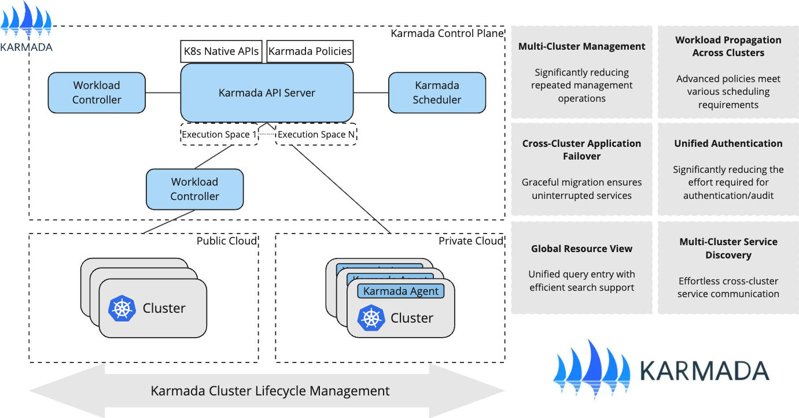
Architecture Overview

Slide 20
Karmada in use at Bloomberg

Slide 21
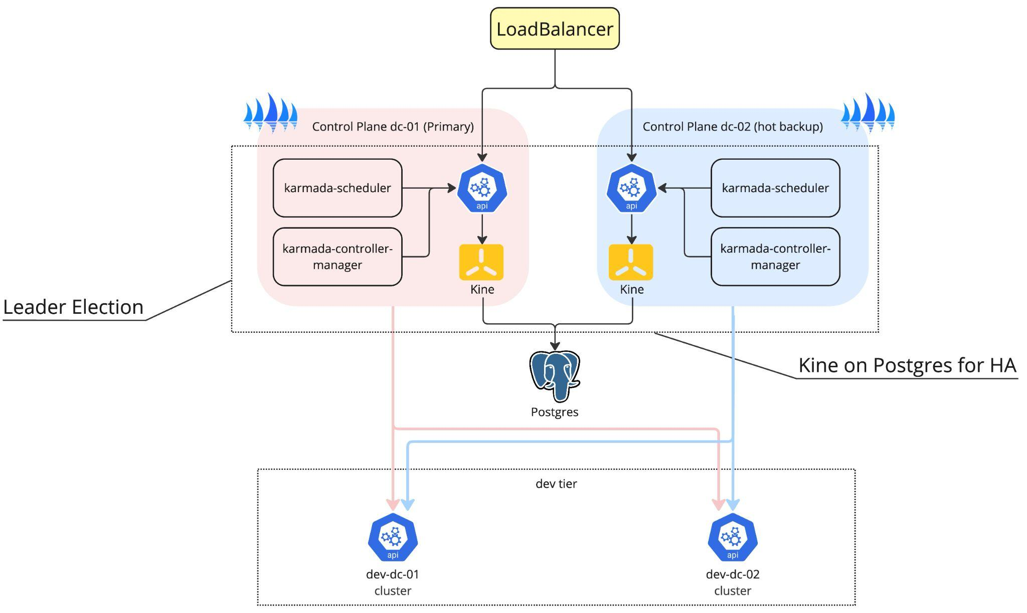
Control Plane Setup
Multi-DC deployment
High-availability with Kine and PostgreSQL
Notes:
Deployed karmada across two datacenters to achieve disaster recovery requirements. Nj-01 and nj-02
Both karmada api server share the same DNS name, achieved by registering them to a Consul-backed DNS service discovery
Only one Karmada-scheduler and one karmada-controller-manager will be working as the leader, and the other one in the other datacenter will be the backup
The default etcd used by kubernetes only resides in a single dc, so we used kine on Postgres to make sure that high availability is guaranteed.
The postgres database can cross multiple datacenters, implemented by the db team at Bloomberg.
Karmada Audit Event: https://docs.google.com/document/d/1QAYEpEjQzHTDb0UQGGY00fO7HMurOKvKHLT9yW9bmTA/edit
Turned on Karmada auditing, benthos + libretto

Slide 22
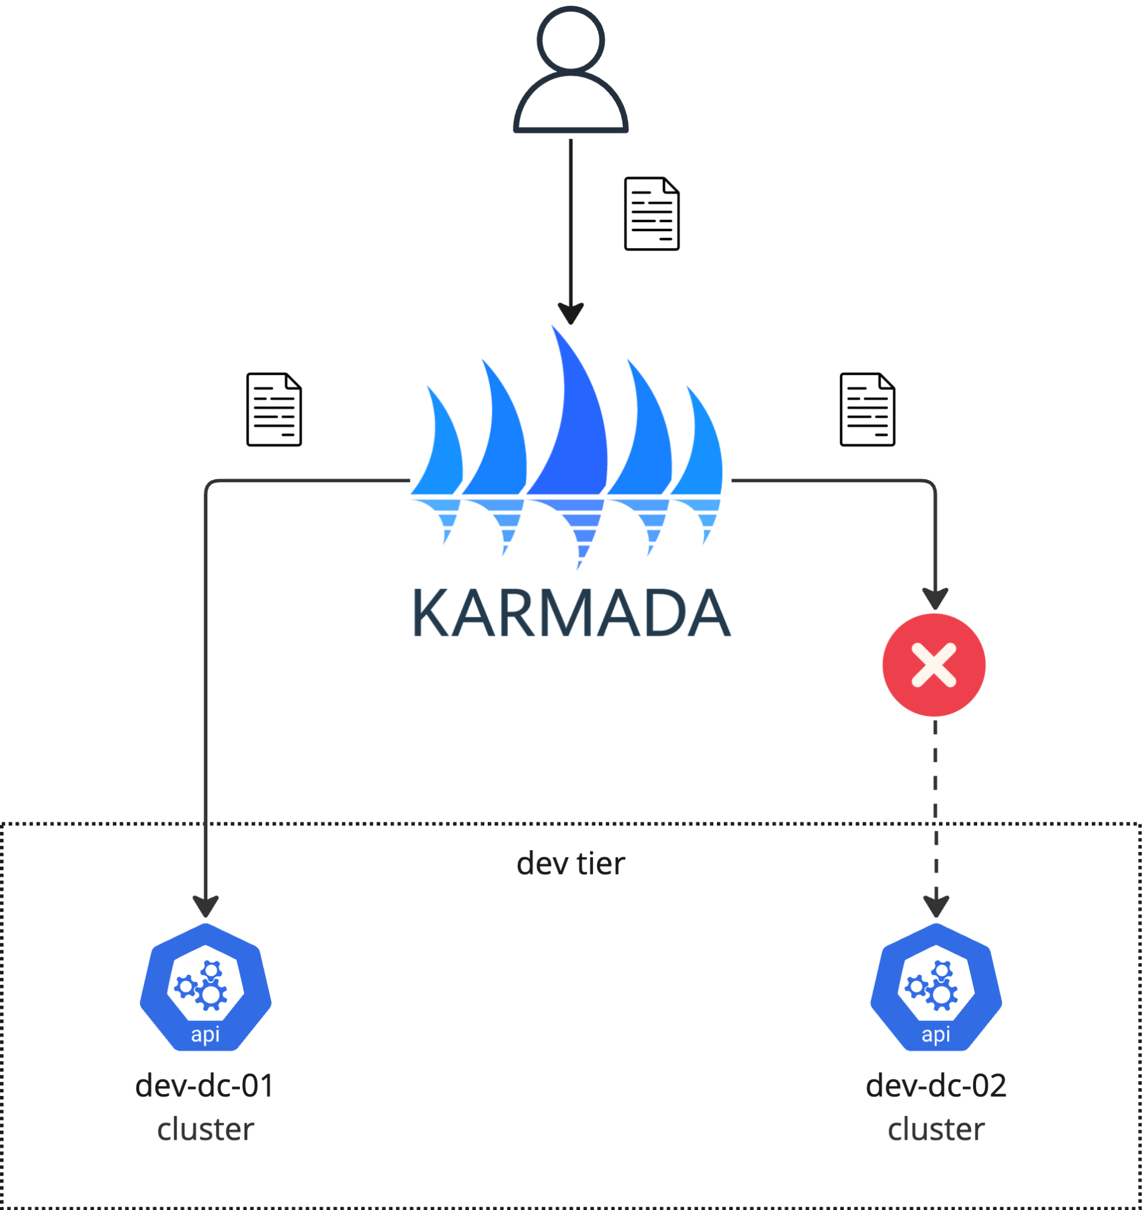
Automatic Failover
Taint faulty cluster as NoSchedule
Schedule workload to the healthy clusters
Notes:
The re-scheduling feature makes more sense for long-running service than for ML training workload. We disable rescheduling feature

Slide 23
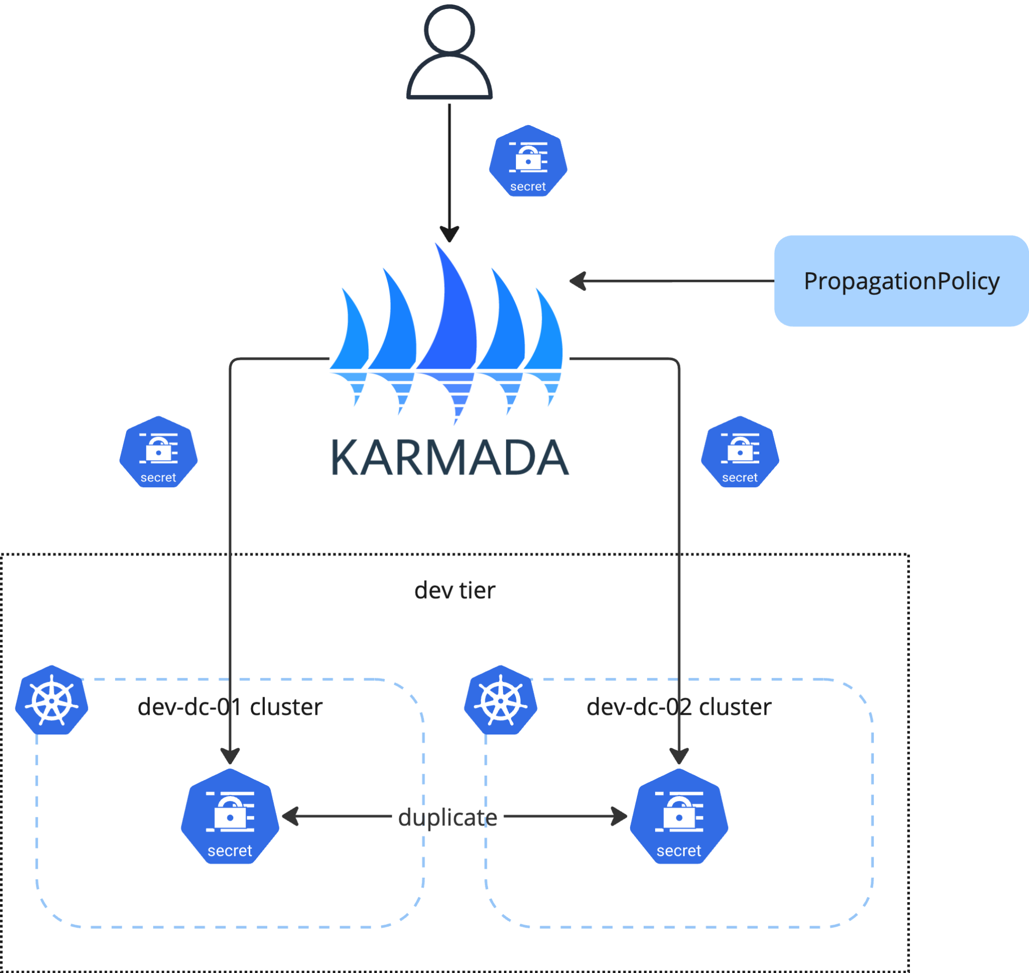
Configuration/Credential Propagation
Automatically propagate configurations and credentials to all clusters under the same tier
One-time creation, access anywhere
Auto-populate to new member clusters

Slide 24
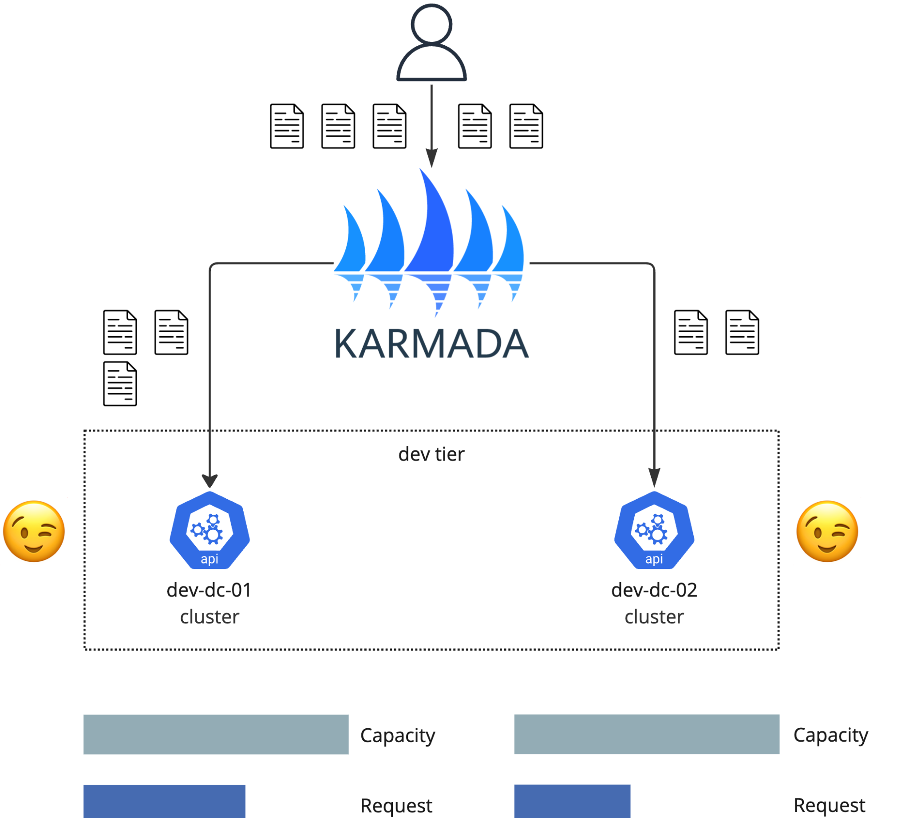
Balanced Scheduling
Automatically balance workloads across different clusters in the same tier

Slide 25
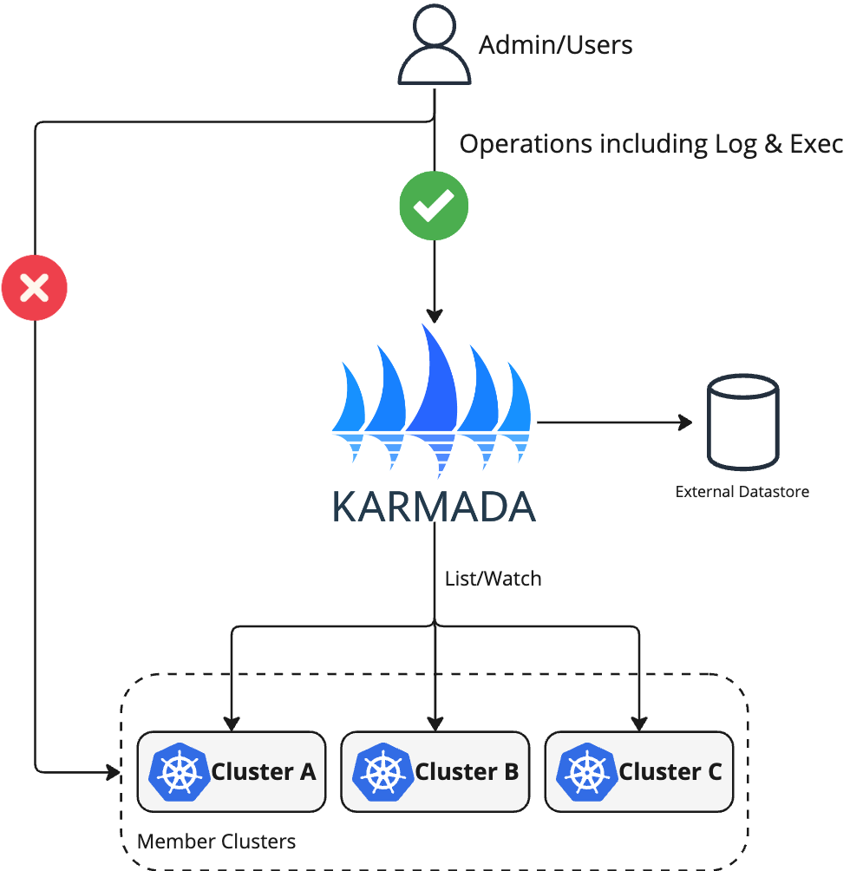
Global Uniform Resource View
Admins/Users are able to perform operations against the resources in member clusters without needing to access member clusters, including log and exec

Slide 26
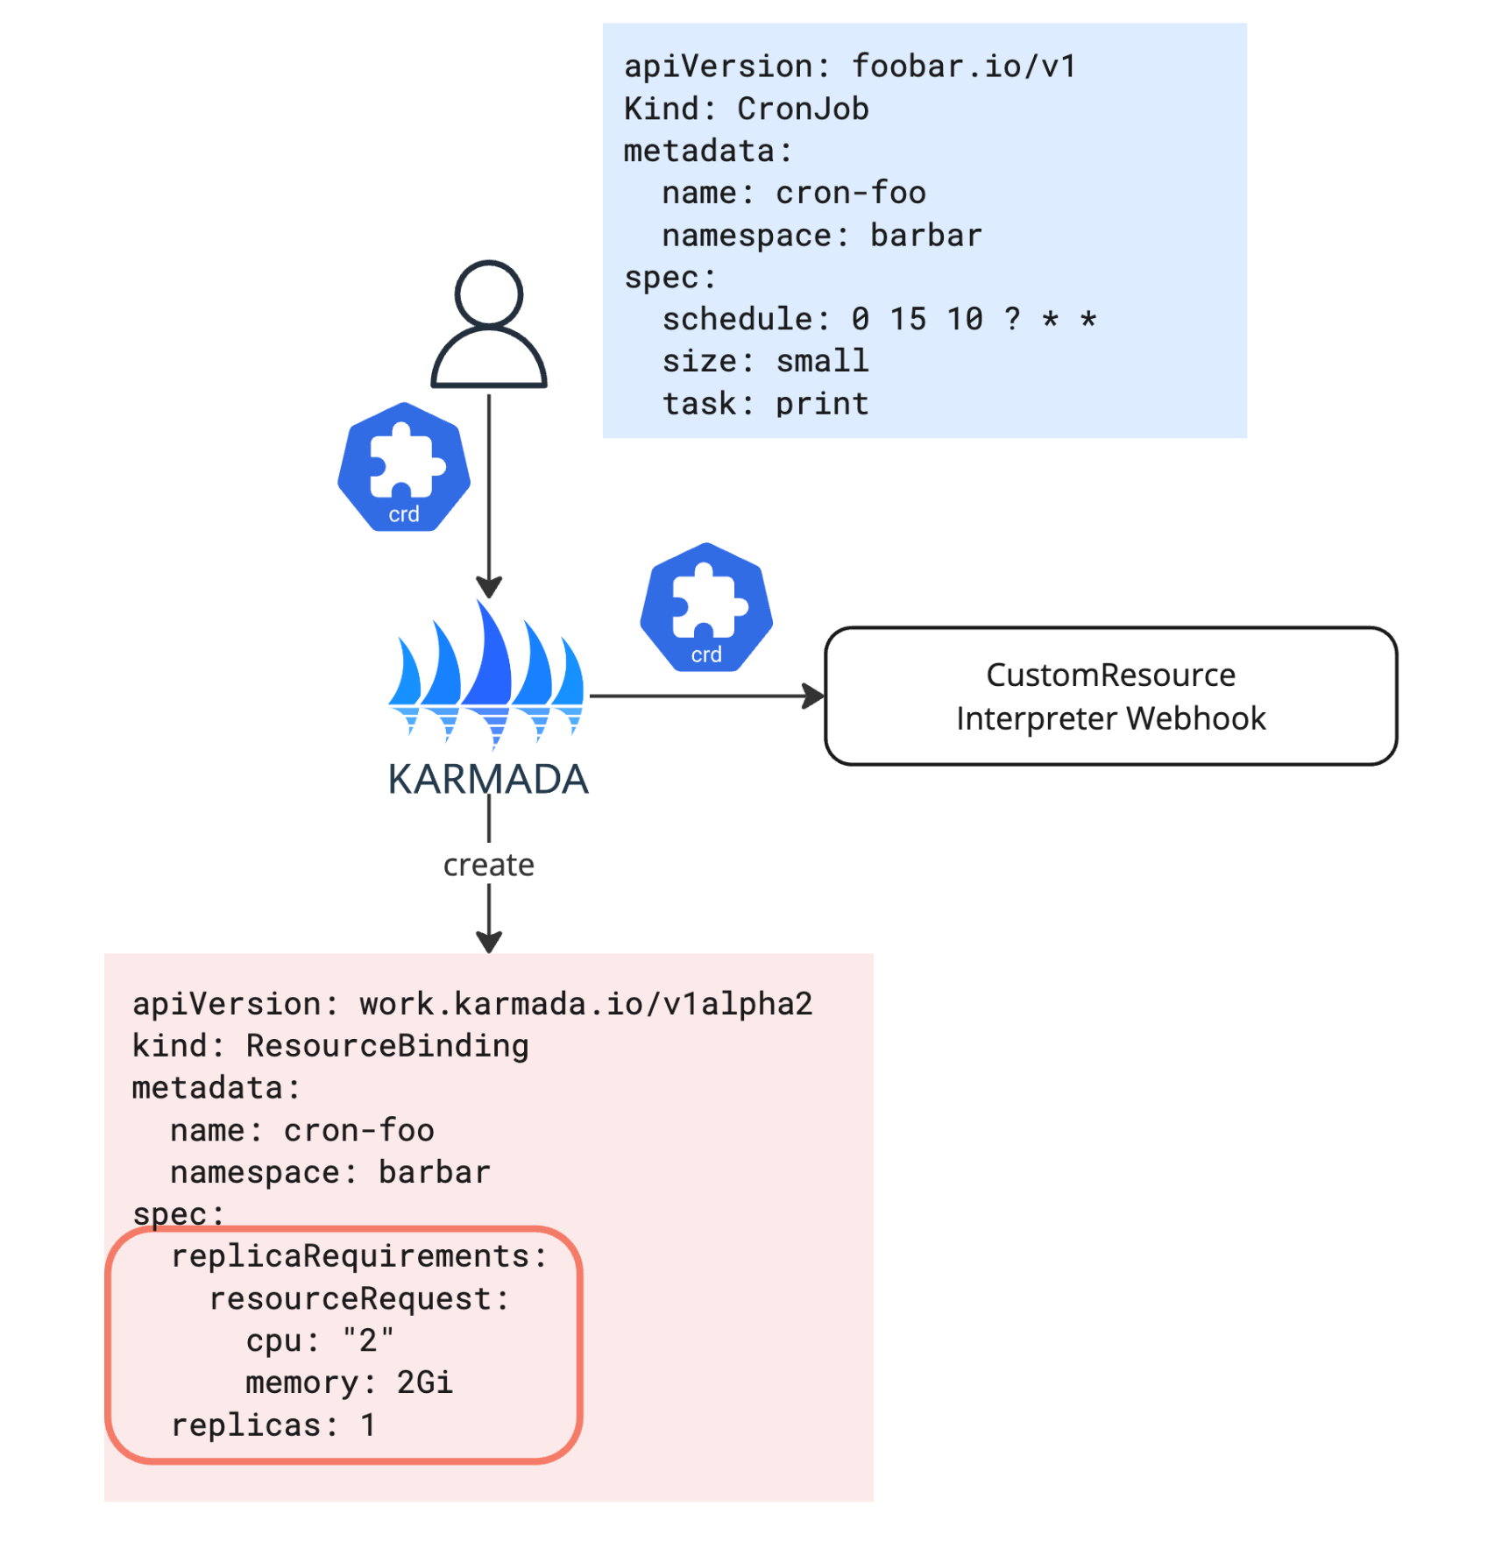
Custom Resource Interpreter
How does Karmada understand your Custom Resource?
→ Resource Interpreter Webhook
Notes:
Karmada cannot be integrated with the Bloomberg tech stack out of the box, so we also customized and contributed a few components to make it work better.

Slide 27
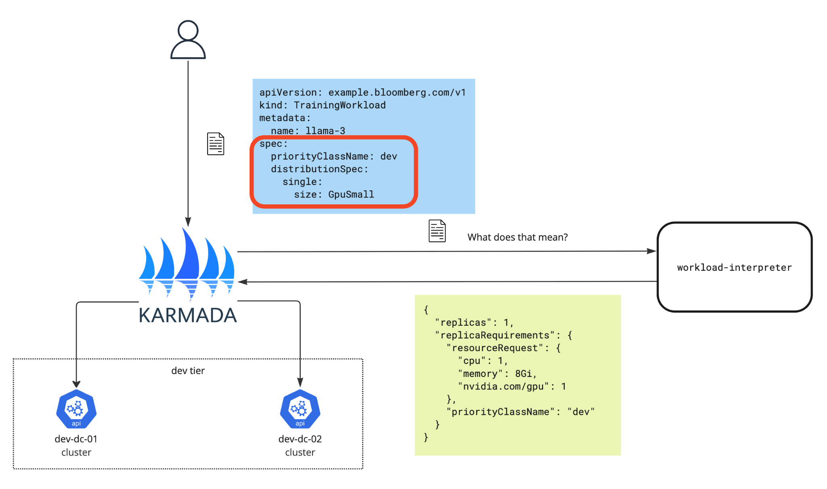
Customized Interpreter
How does Karmada understand your Custom Resource?
→ Resource Interpreter Webhook
Notes:
At bloomberg, a batch ML training job is called a “ComputeJob”. This is a kubernetes CRD that karmada does not know about by default. We wrote a computejob-interpreter to help karmada understand what is a computejob. It provides information including the replica a certain computejob requires, and the hardware resources that each replica would need. Therefore, karmada is able to make better scheduling decisions based on the information.
ComputeJob is a wrapper around kubeflow job
GpuSmall is an internal definition.
Supports any kind of extended resource, gpu is one of them.

Slide 28
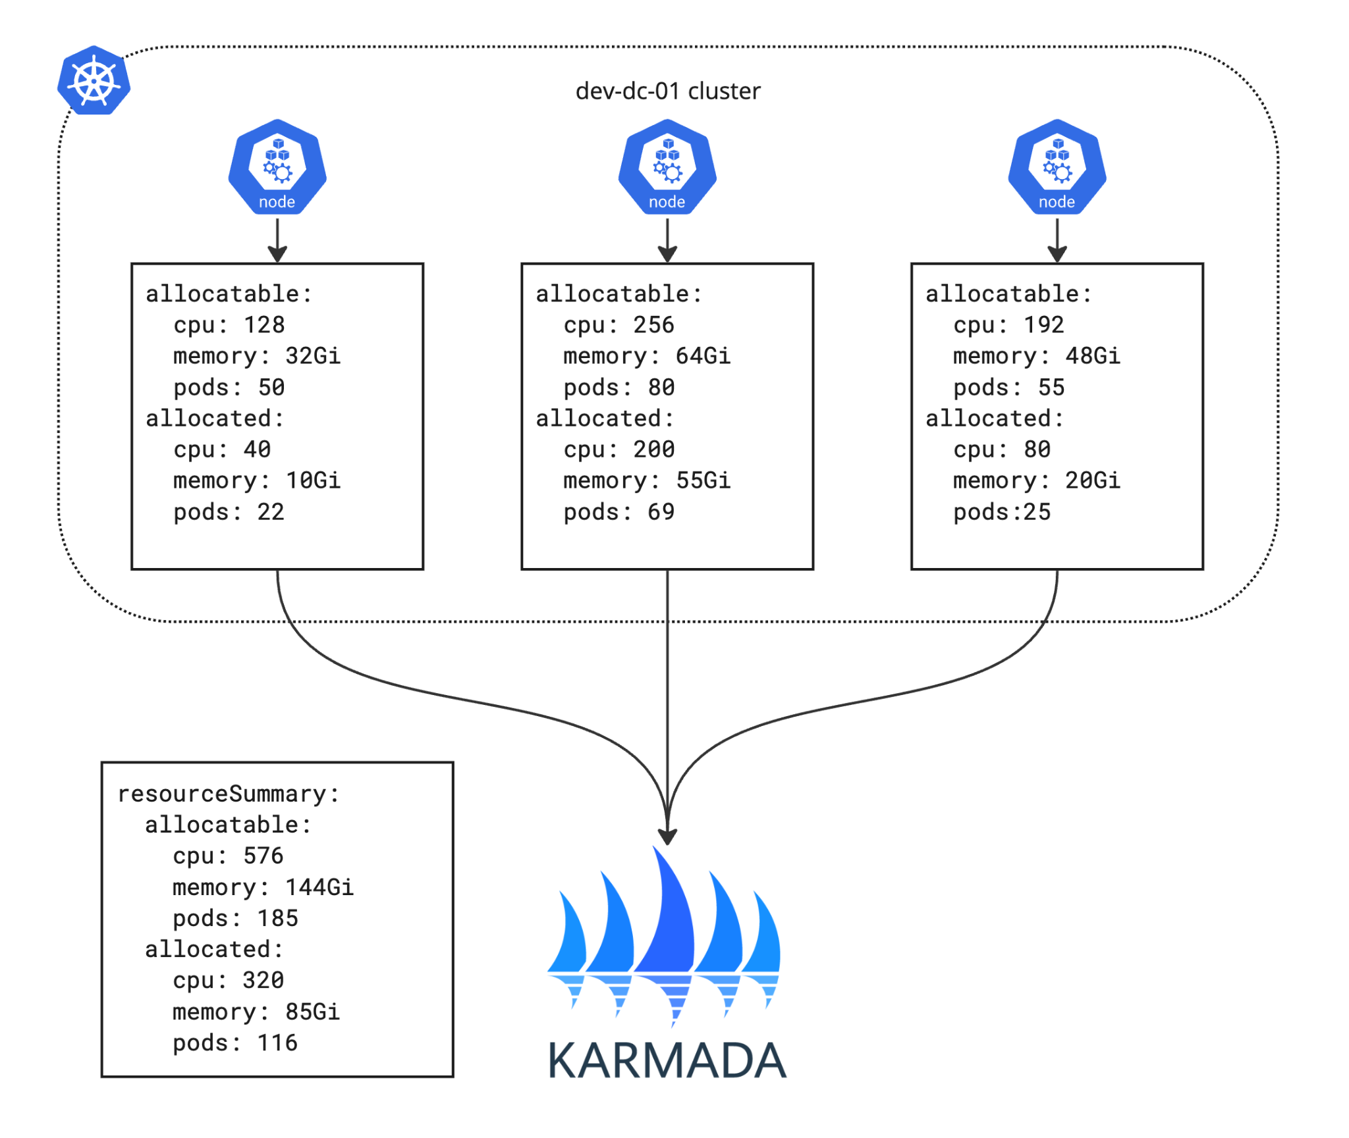
Resource Modeling
Calculates free resources on the entire cluster
Fast, but not accurate
Notes:
Resource modeling tells Karmada By default, karmada makes schedule decisions based on the free resources of the entire cluster, without taking into account the individual situation of each node. Karmada simply adds up the allocatable and allocated resources on each node to get the total allocatable and allocated resource of a cluster. Free resource is calculated by subtracting allocated amount from the allocatable amount.
This approach runs fast, but is not accurate.

Slide 29
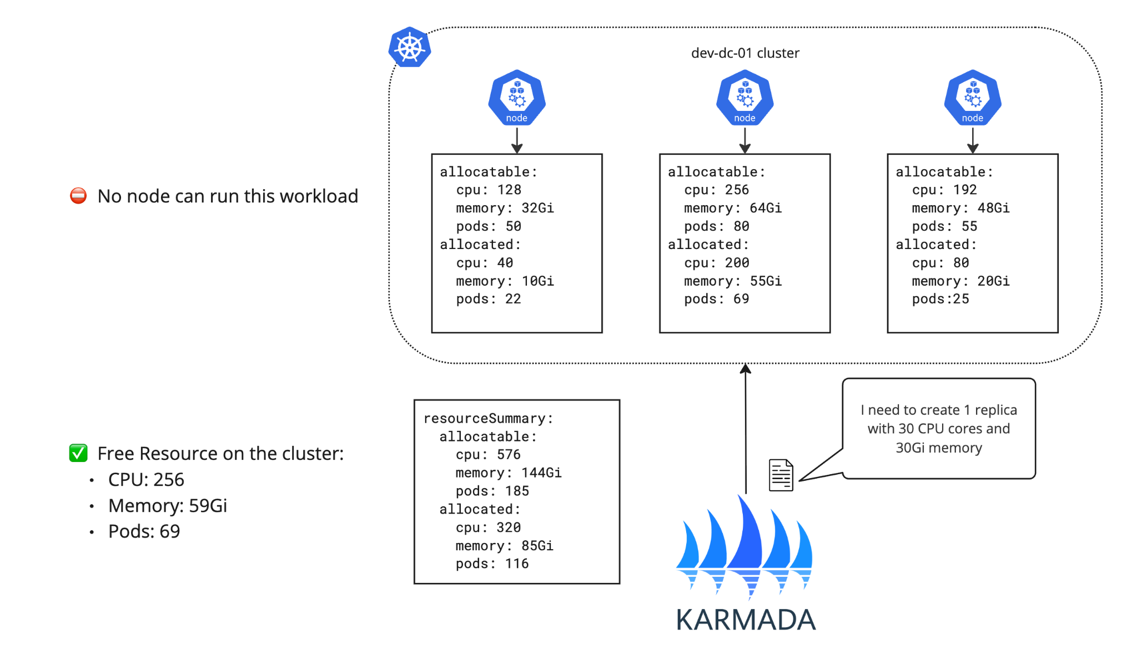
Resource Modeling

Slide 30
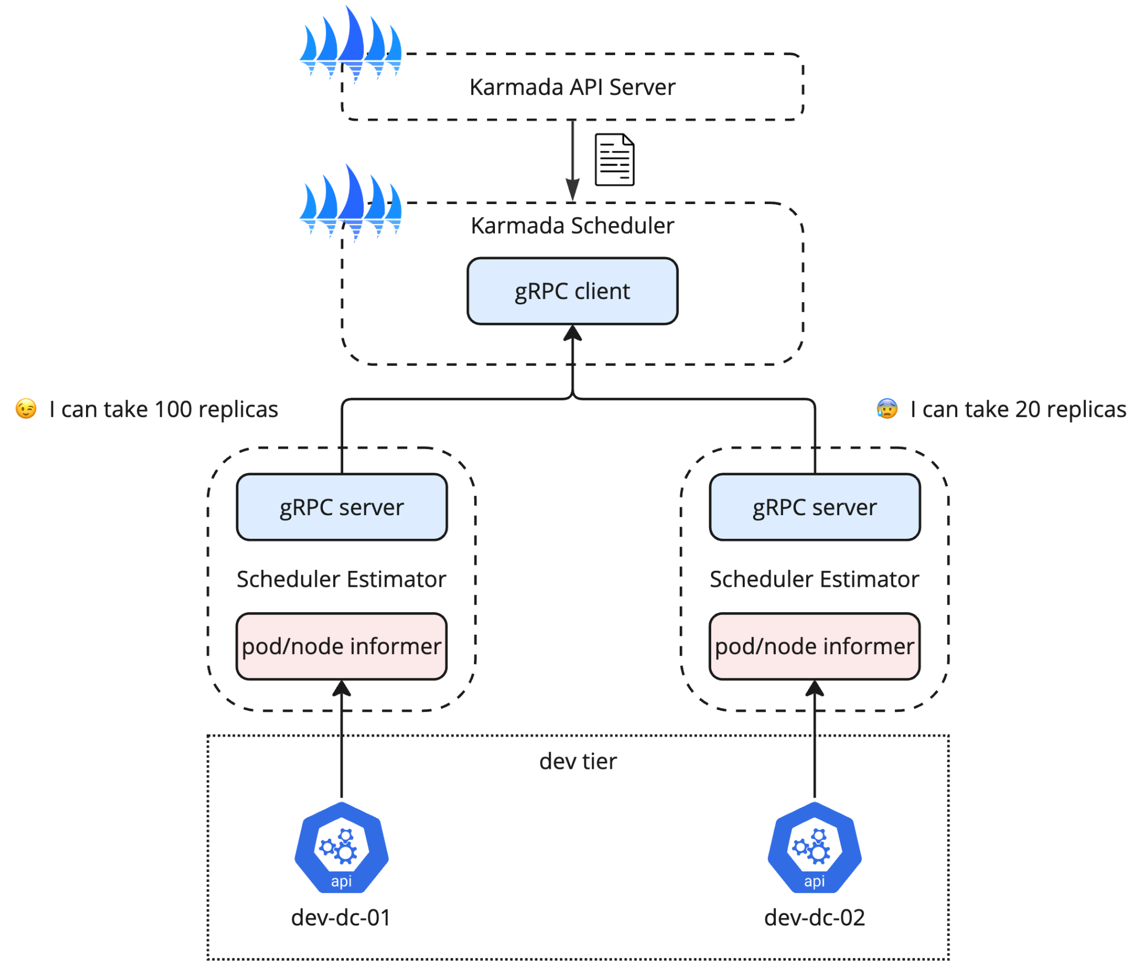
Scheduler Estimator
Provide accurate information for Karmada-Scheduler
R1: #replicas that a node can be divided into in terms of hardware resource
R2: the maximum remaining pods that the node allows
Amount of replicas that can be taken:
sumByNode(min(R1, R2) per node)
Proposal #521
Notes:
The scheduler estimator helps the karmada scheduler to better understand which cluster has required resources to run the workload. It is a gRPC server that takes requests from the Karmada scheduler, and one estimator is only connected to one member cluster. Each scheduler estimator instance owns a pod informer and a node informer, which listens to the pod and node events on the associated member cluster, and calculates the number of replicas the member cluster is able to take.
The scheduler estimator is powerful, it supports nodeAffinities, node selectors, taints and tolerations

Slide 31
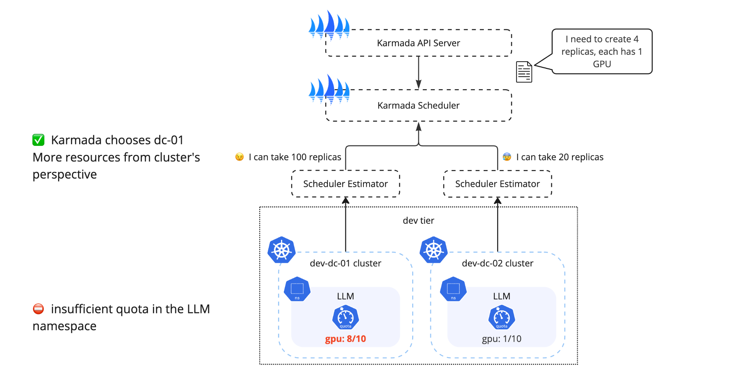
Scheduler Estimator
Notes:
The scheduler estimator does not support resourcequota, which Bloomberg uses to manage quota of different namespaces. Since the scheduler-estimator does not take resourcequota into account, it will choose nj-01 to run the job because this cluster has more resource in total, but in fact the namespace cannot accept it because of quota limitation. As a result, the job would hang in pending state on the member cluster, until previous jobs finish and release the GPUs that they use.

Slide 32
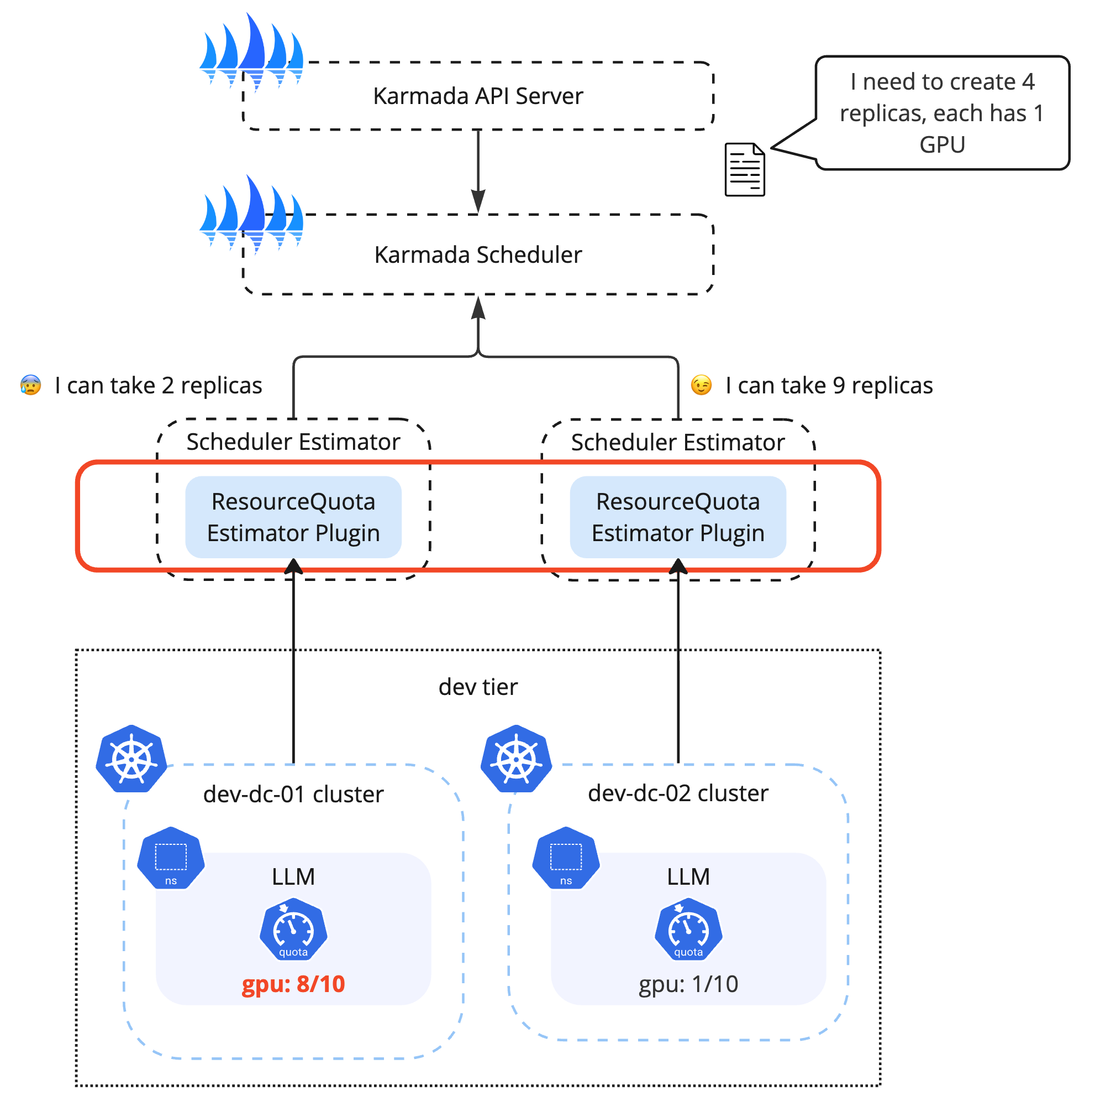
ResourceQuota Estimator Plugin
Checks the remaining ResourceQuota in the target namespace
Applies to PriorityClass-scoped ResourceQuota
Notes:
In order to make karmada scheduler aware of the resourcequota of each namespace, and also take that into consideration when making scheduling decisions, we implemented a ResourceQuota Estimator Plugin.
Inside the plugin there is an resourcequota informer, which listens to resourcequota events in the cluster.
This plugin only supports priorityclass-scoped resourcequota at this point.

Slide 33
Future Project Roadmap

Slide 34
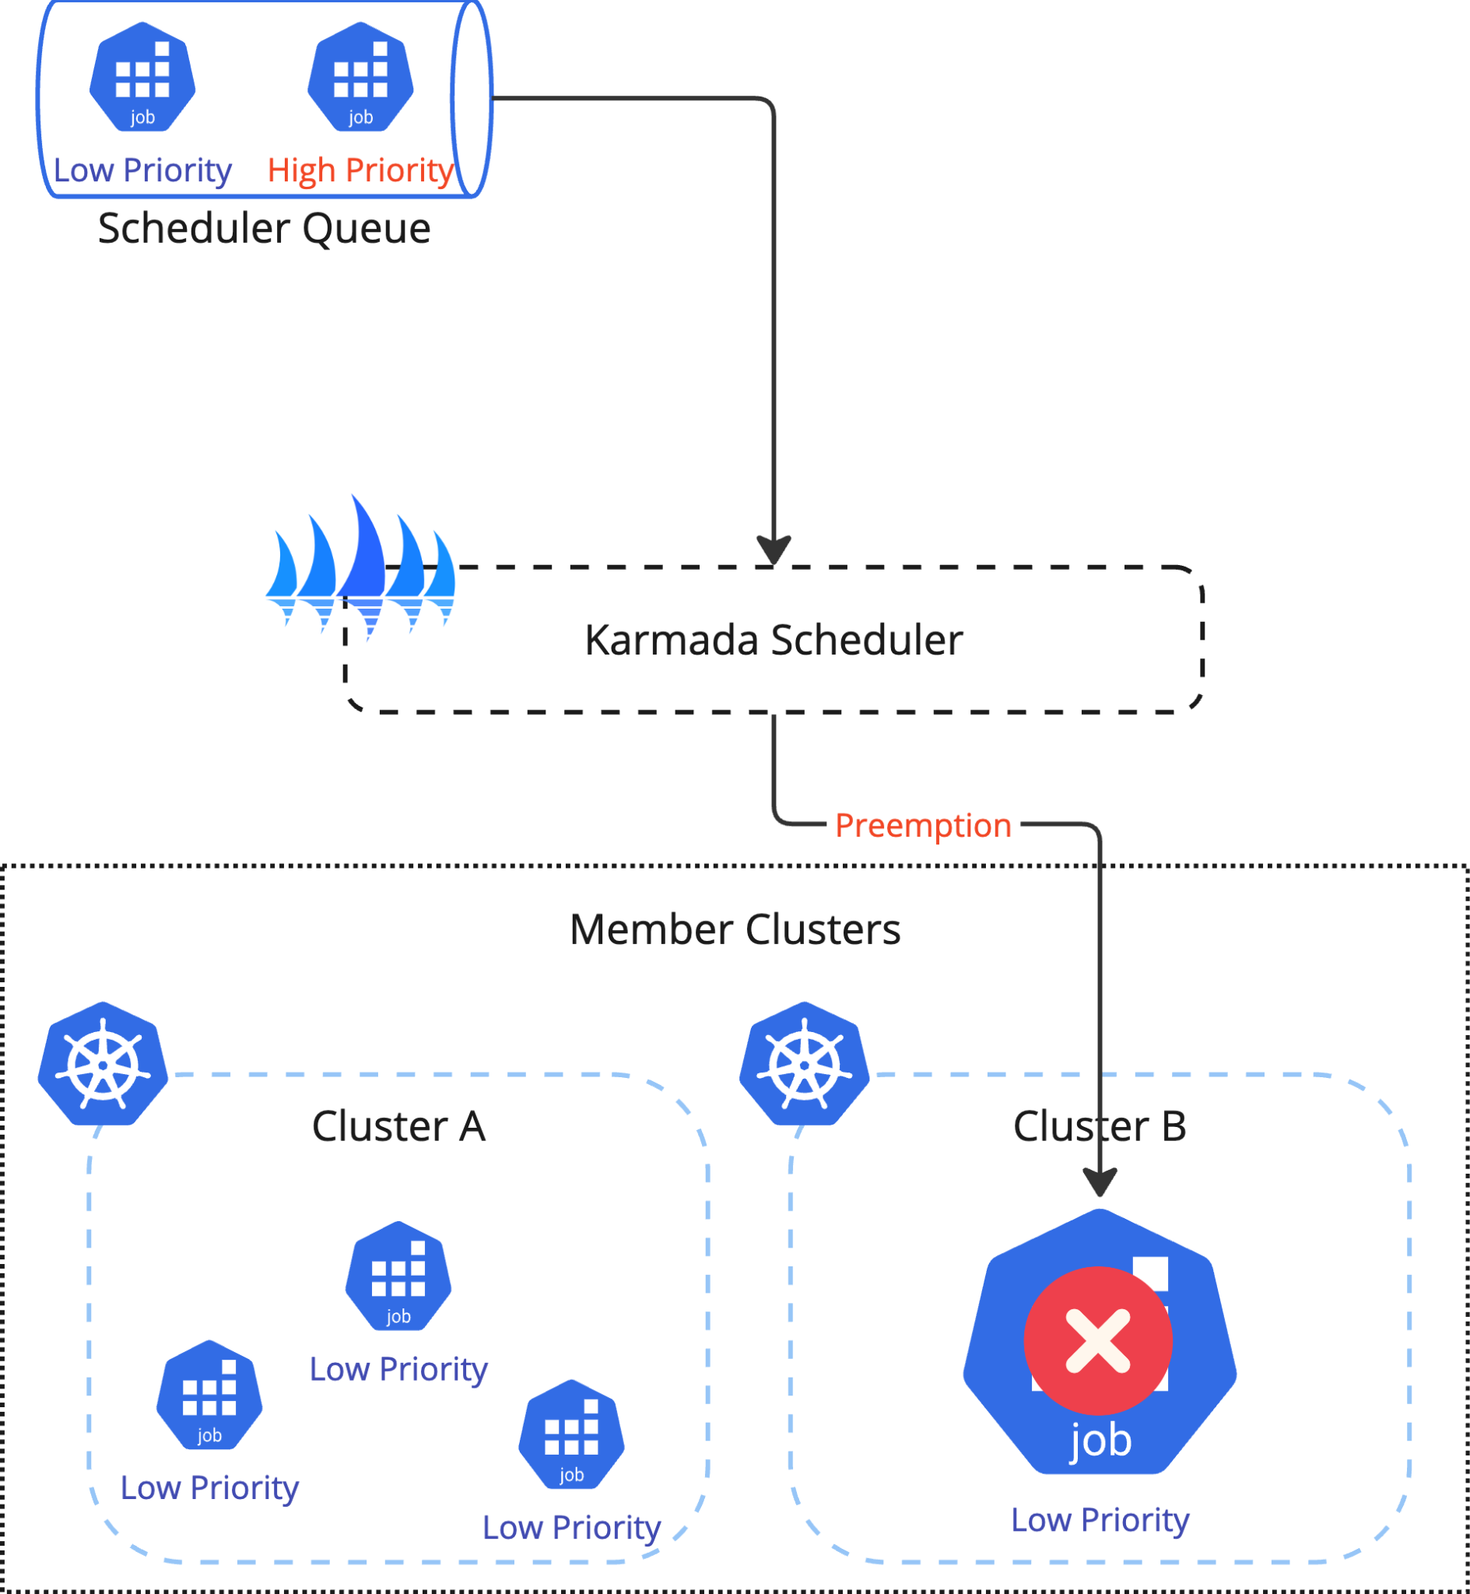
Priority & Preemption
Ensure that critical workloads have preferential access to resources
Ensure optimal resource utilization and availability for essential workloads
PR #4993: Propose binding priority and preemption
Notes:
We are working with the community for priority & preemption feature.

Slide 35
Thanks!
Questions?
Notes:
We generally don’t talk about what kind of hardware we have e.g. H100 + Infiniband, we don’t talk about any production benchmark results, we don’t talk about actually capacity e.g. number of GPUs or clusters or data centers.
Might have questions about ResourceQuota estimator plugin.
Might have questions about Priority & Preemption.

